Slide 1
Final Project Proposal
Group 2

Slide 2
Project Description
We are Planning to develop a Data warehouse solution for Stack overflow platform.
The data warehouse can help Stack overflow to achieve their analytical need like user interests, membership info, users active participation & latest technology trend being discussed on their platform, etc.
Stack overflow can improve their advertising and marketing revenue model by analyzing these users activities, interest and engagement metrics.
This can also help Stack Overflow with providing better job recommendation to end users who are actively looking for change. This improved jobs listing model can help them to increase their ad revenue business.
This data warehouse can also provide 360 degree perspective to stack overflow platform to understand other aspects of data for improving their platform performance.

Slide 3
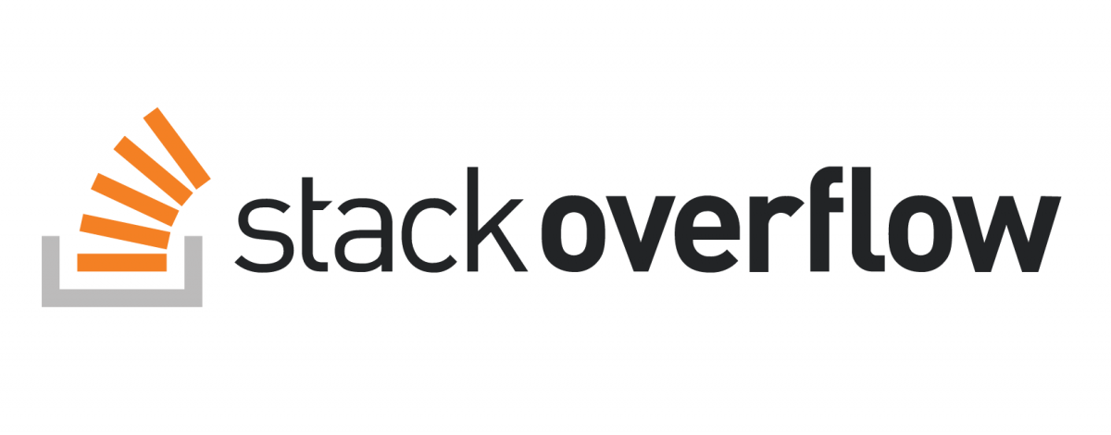
About Data
Stack Overflow - Stack Overflow is a question and answer website for professional and enthusiast programmers.It features wide range of topics in the world of computer programming. They also provide membership options along with job portal features for their customers.
Data Source - https://relational.fit.cvut.cz/dataset/Stats
We are acquiring datasets from RELATIONAL DATASET REPOSITORY (An anonymized dump of all user-contributed content on the Stats Stack Exchange network)

Slide 4
Summary of Datasets
Entities in Data Warehouse-
Posts
Comments
Tags
Users
Posts History
Post Links
Votes
Badges
Method of access-
For extracting data from the internet open source we are using mysql connector in python environment and loading all the relevant data into the AWS S3 bucket for storage/Staging.
Data Quality-
There are some missing values in the datasets which will deal according to the requirement.
Basic Exploratory analysis (EDA) is being performed in python environment.

Slide 5
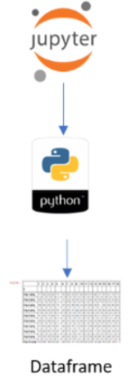
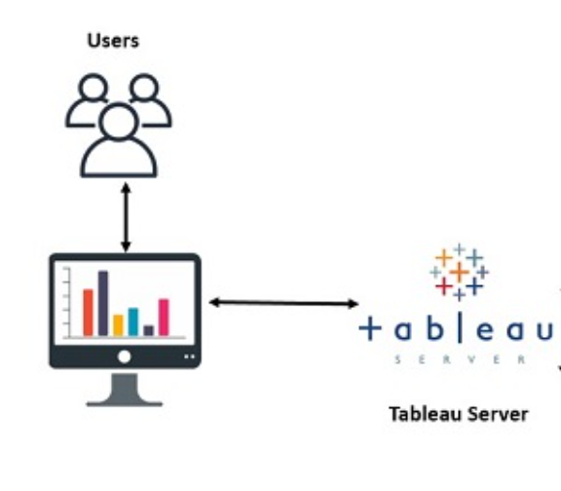
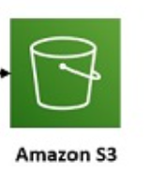


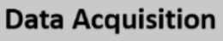

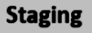
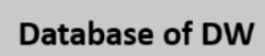
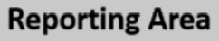
Data Flow

Slide 6
Roles and Responsibilities
Surbhi - AWS Architect:
Design the overall architecture of the system and grasp the entire project.
Nosson - Data Collector:
Collect relevant data according to the needs of the system and users.
Yihang - Database Administrator:
Operate, maintain and manage of database management systems.
Yifeng - Database developer:
Design and develop database management systems.
Qianwen - Data Analyst:
Analyze and visualize data, and make industry assessments and forecasts based on data.

Slide 7
Timeline of the Project
For our project we are planning to use Waterfall Methodology for organization and development.
Week 1
Week 2-3
Week 4
Week 5
Week 6
Research and Analysis
Requirement,Design and Development Phase-1
Development Phase-2 and Testing
Organization and Presentation
Development Phase- 3
and Testing

Slide 8
Thank You !

